Slide 1

Enhancing Stock Price Prediction for Nifty 50 IT Sector Companies: A Comparative Study of ML Models with Feature Selection and Event Data Integration Economics and Finance
Zeroth Review
Course Code: CS6510
Course Title: Project 1
24MSP3038
Aniket Shinde
12/11/2024

Slide 2
Problem Statement
Stock price prediction is a challenging task due to the inherent volatility and complexity of financial markets, particularly within the IT sector, where rapid technological and economic changes significantly impact stock performance. Traditional predictive models that rely solely on historical price data often fail to capture the influence of market-moving events, such as earnings reports, policy changes, and global economic shifts, which are especially pertinent to IT companies. This study aims to enhance the accuracy of stock price predictions for Nifty 50 IT sector companies by integrating event-driven data with feature selection into machine learning models. By comparing the performance of ARIMA, SARIMA, and LSTM models, this research seeks to identify a modeling approach and feature set that more accurately capture the dynamic relationships between stock trends and relevant external events, ultimately providing investors and analysts with a more robust decision-making tool for this volatile sector.

Slide 3
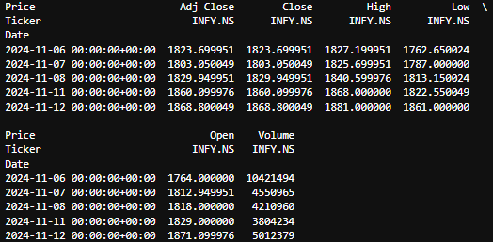
Dataset
Source of the Dataset: Yahoo Finance API
No. of Observations: 7252
Column/Feature Details: Adj Close, Close, High, Low, Open, Volume
Screenshot of the dataset:

Slide 4
Review of Related Literature
Base Paper:
Mohan, B., Yadav, A., Toleti, J., Reddy, D. S. S., Ahmed, R. K., & Koushitha, G. (2024). Sentiment-driven predictive models for Nifty 50 stock market fluctuations: A time series analysis perspective. IEEE International Conference on Information Technology, Electronics and Intelligent Communication Systems (ICITEICS), 70, 1–8. https://doi.org/10.1109/iciteics61368.2024.10625537
Link to Paper
Paper I:
Panchal, S. A., Ferdouse, L., & Sultana, A. (2024). Comparative analysis of ARIMA and LSTM models for stock price prediction. 2024 IEEE/ACIS 27th International Conference on Software Engineering, Artificial Intelligence, Networking and Parallel/Distributed Computing (SNPD), 240–244. https://doi.org/10.1109/snpd61259.2024.10673919
Link to Paper
Paper II:
Rajhans, A., Das, T., Kumar, A., & Sinha, B. B. (2024). Exploring the impact of financial news sentiment on stock price forecasting: A comparative deep learning approach. 2024 1st International Conference on Communications and Computer Science (InCCCS). https://doi.org/10.1109/incccs60947.2024.10593315
Link to Paper
Paper III:
Taslim, D. G., Tjahyadi, H., & Murwantara, I. M. (2024). A study of LSTM optimisation for forecasting volatile time series data. 2024 4th International Conference on Computer Communication and Artificial Intelligence (CCAI). https://doi.org/10.1109/ccai61966.2024.10603183
Link to Paper
Paper IV:
Amruth, S. J., Nigelesh, T., Shruthik, V. S., Reddy, V. S., & Venugopalan, M. (2024). Time-series-based stock market analysis using machine learning. 2024 15th International Conference on Computing Communication and Networking Technologies (ICCCNT), 1–7. https://doi.org/10.1109/icccnt61001.2024.10725232
Link to Paper

Slide 5
Impact of the Proposed Research
This project aims to enhance stock price prediction accuracy for the IT sector of the Nifty 50, leveraging machine learning (ML) models with refined feature selection and event-driven data integration. By optimizing feature selection and incorporating relevant economic events, the research seeks to develop a predictive framework that is more responsive to market dynamics, potentially offering improved performance over traditional forecasting models. The insights gained can benefit investors, analysts, and financial institutions by providing a more nuanced understanding of price movements, improving decision-making, and reducing risk in volatile markets. Additionally, this research could pave the way for future predictive studies across other sectors.

